Slide 1
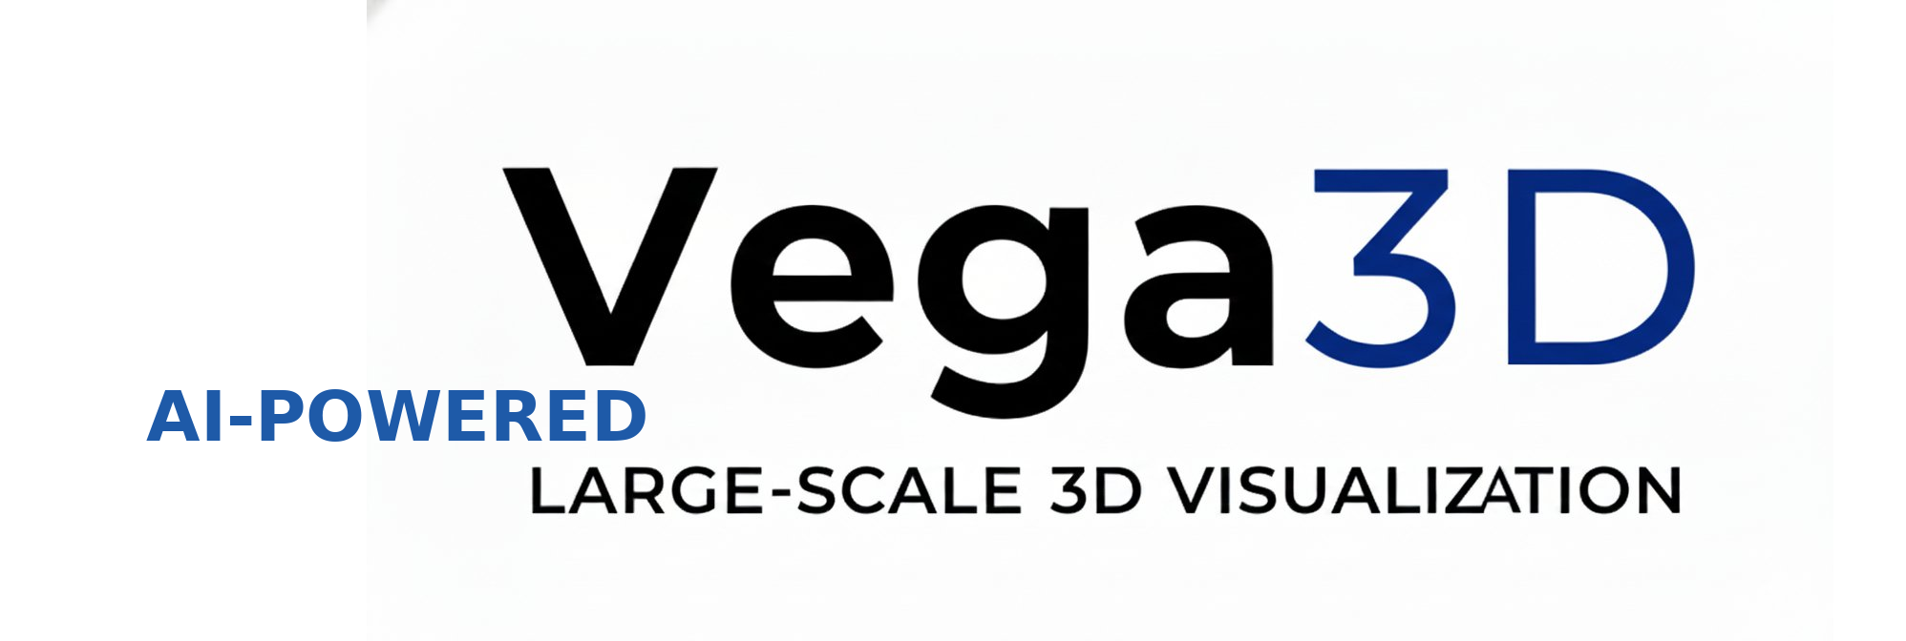
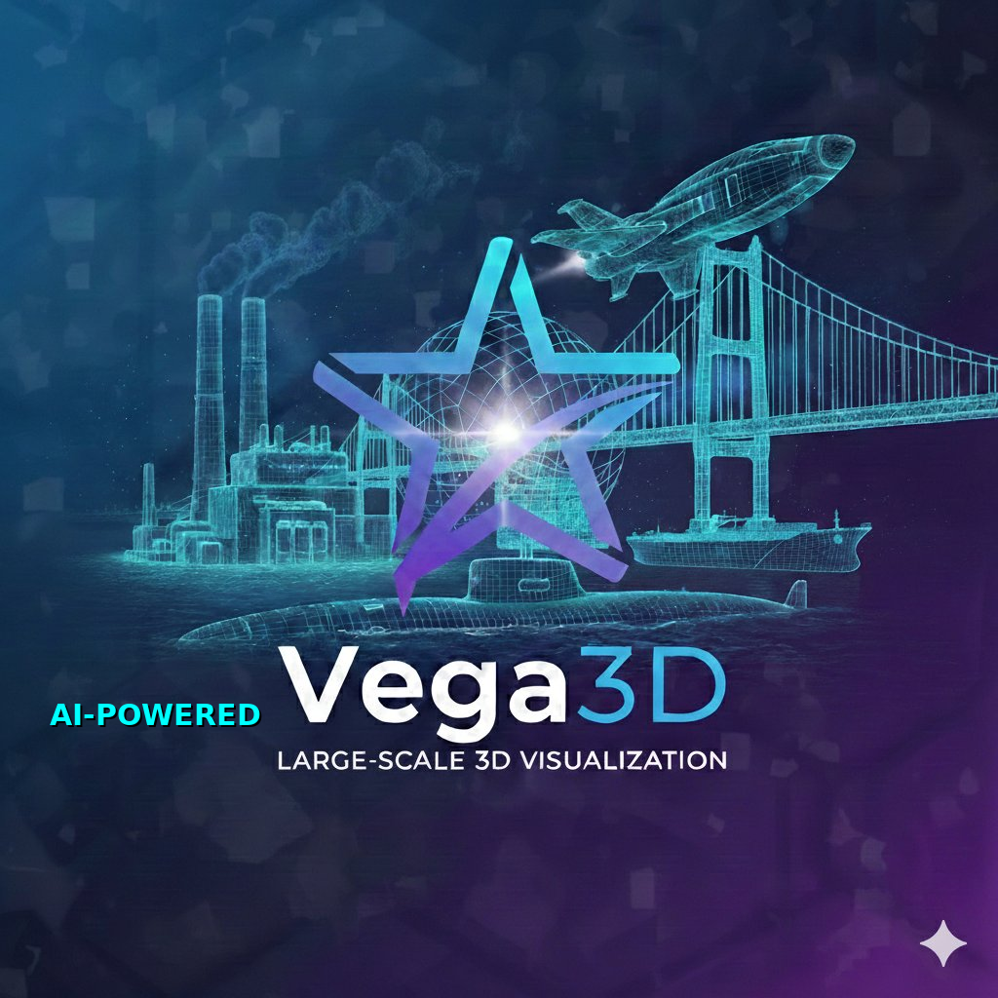
Rev.4
vega3d.xyz
PRODUCT CATALOG · 2026
AI-Powered
Large-Scale 3D Visualization
Real-time visualization of massive 3D datasets,
AI-driven decision support for industrial operations.
01
02
Visualization Solutions
Marine Solutions
vega3d.xyz
01 / 08

Slide 2
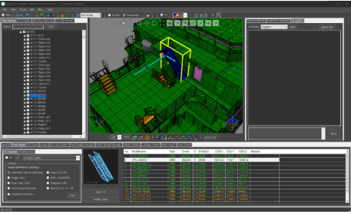
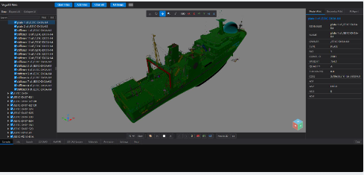
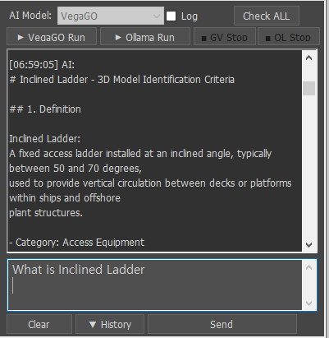
01 · Visualization Solutions
01
Visualization Solutions
Real-time rendering engine for massive 3D datasets, built on Web & PC.
V11
Vega3D X
CAD System Synchronized, Large-Scale 3D Model Visualization
★ Real-time rendering of CAD models(PC) ★ Load rev/rvm/glb/etc.
★ Measurement / Slicing / Clipping ★ Import iges/stp/etc.
★ 2D Drafting Mode ★ Model & Geometry Attribute
★ Model Collide Check ★ Avatar
V12
Vega3D Web
Web-based Large-Scale 3D Model Visualization Collaboration
★ Real-time rendering of CAD models(Web) ★ Load rev/rvm/glb/etc
★ Measurement / Slicing / Clipping ★ Import iges/stp/etc.
★ Model & Geometry Attribute ★ Avatar
★ Model Collide Check ★ Collaboration System
V13
VegaGO
AI Agent Engine
★ Local LLM Integration — Private AI, no internet required
★ No usage-based cost — flat-rate, on-premise deployment
★ RAG System — Shipbuilding & plant engineering knowledge base
★ Compatible with Vega3D X & other 3D solutions
vega3d.xyz
02 / 08

Slide 3
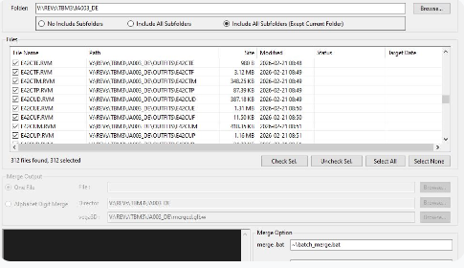
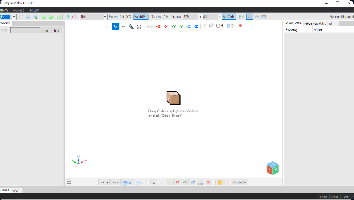
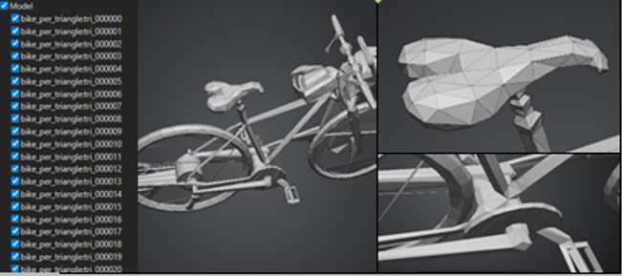
01 · Visualization Solutions
01
Visualization Core
Real-time rendering engine for massive 3D datasets, built on WebGL and WebGPU.
V14
Vega3D Converter
Fast File Format Converter & Merge
★ Folder batch scan — include/exclude subfolders
★ Merge Mode — One File or Alphabet Digit grouping
★ input formats: rev/rvm/glb/glbm/glbx/etc.
★ Output formats: glb/glbm/glbx/etc. ★ Batch Run
V15
Vega3D Vibe Kit
AI SDK · Developer Kit
★ Any AI, Any Origin — US · Chinese · Free · Paid · Web · PC, all supported
★ No dev experience requ.- simple features ~30 min, busi. features ~1 day
★ 28+ command unified protocol - single JSON schema for all LLM adapters
★ Vibe Coding Support ★ Vibe Kit Template or Embed Kit
V16
Vega3D ScanTo3D
Reality Capture · AI · CAD Automation
★ Zero-equip. capture - iPhone / Android / DSLR / Drone, any camera works
★ 7-stage AI pipeline : Capture - Reconstruct - Register - Segment - Classify - CAD – Deliver ★ Auto CAD generation
★ iPhone LiDAR + photogrammetry fusion - depth accuracy with full texture
vega3d.xyz
03 / 08

Slide 4
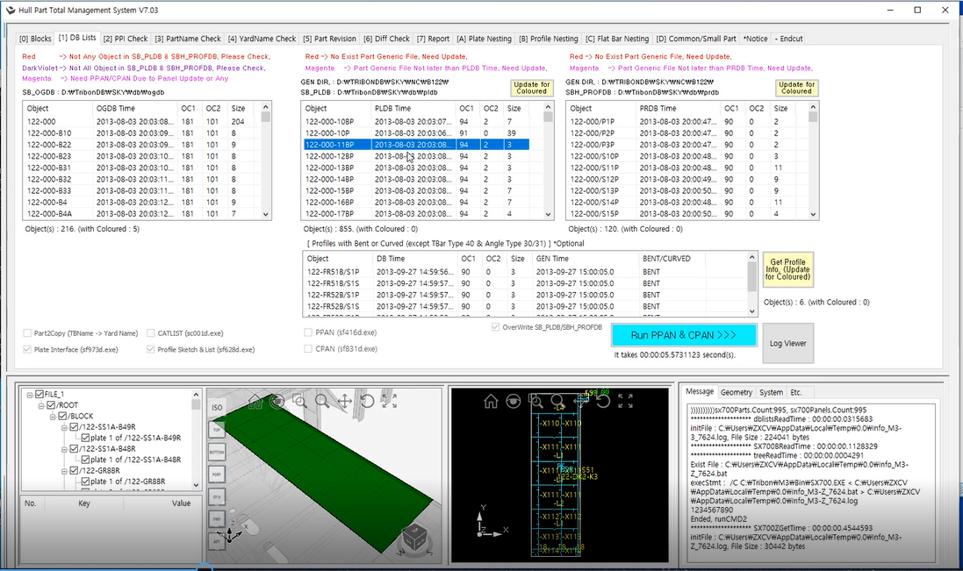
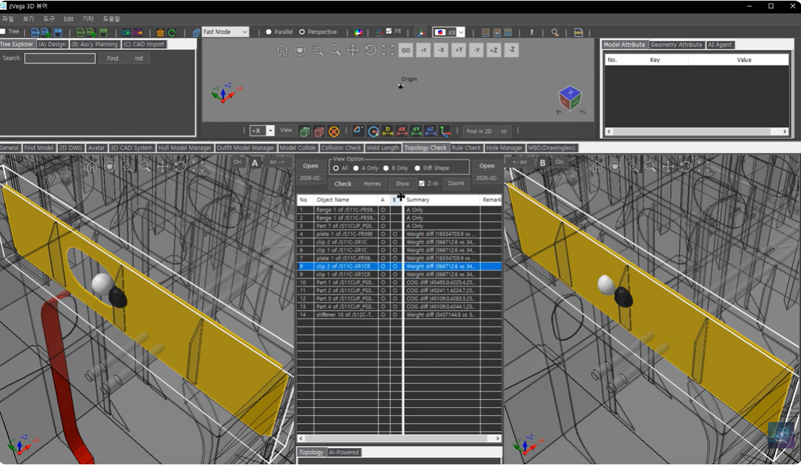
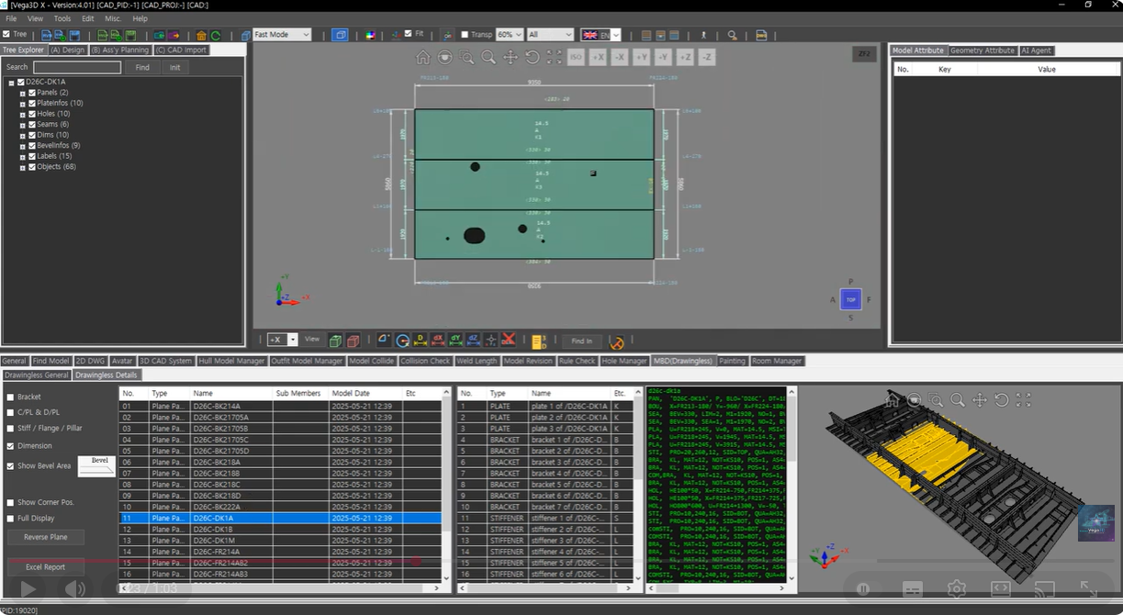
02 · Marine Solutions
02
(A)
Marine Solutions
AI-driven analysis, search and generation across your 3D data.
M11
Hull Part Manager
Fast File Format Converter & Merge
★ Real-Time Interface of Hull Block Model(3D CAD Sytem)
★ Summary Tables for Nesting(Plate/Profile/F-Bar) Systems
★ Production Split Check ★ Report BOM (Ass’y & Cutting)
★ Support PPAN/CPAN ★ Include Part Revision Check
M12
Nesting Solution
Fast File Format Converter & Merge
★ Plate / Profile / F-Bar Nesting
★ Support Pre-Nest also
★ Generate NC-Code
★ Generate Excel-BOM (Ass’y / Cutt’g) with Diff. Check
★ Interface/Export to CAD System(Tribon M3 / Aveva Marine 12).
M13
Drawingless (MBD)
Real-Time Drawingless Solution
★ Automatically interpret plate geometry and dimension.
★ Fast and efficient hull part generation and verification.
★ Bevel shape visualized directly on 3D hull parts.
★ Outfit Model such as pipe spools can also be applied.
vega3d.xyz
04 / 08

Slide 5
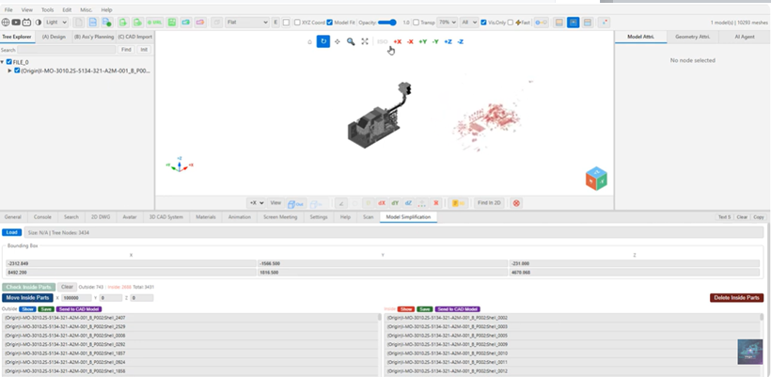
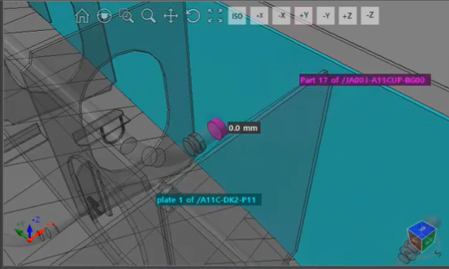
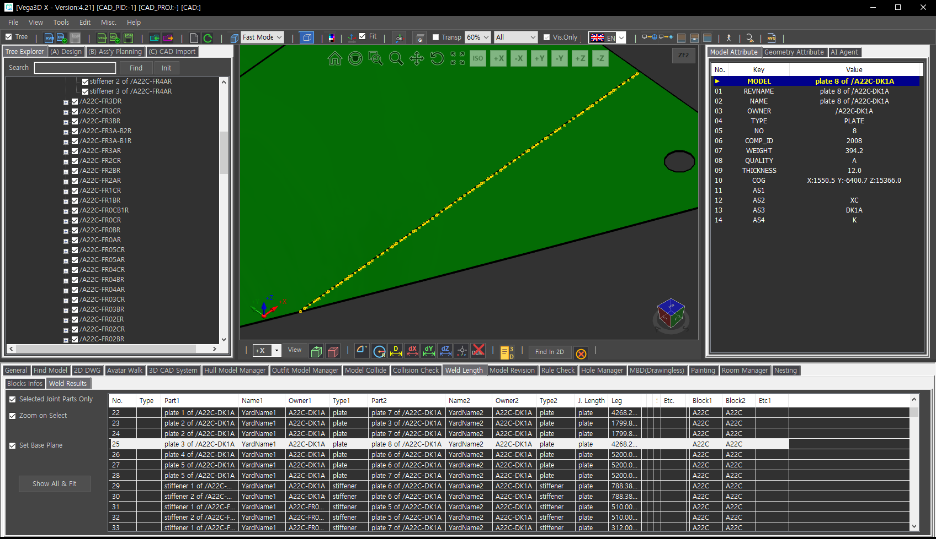
02 · Marine Solutions
02
(B)
Marine Solutions
AI-driven analysis, search and generation across your 3D data.
M14
Lightening Model
Fast Lightening 3D Model Shape & File Size
★ Convert STEP/IGES files into lightweight models, then further optimize
by separating them into Exterior and Interior models.
★ Supports output in various formats including .STEP/.IGES and .GLB, and
can also generate CAD models directly for platforms such as AVEVA.
★ Easily reduce model data while maintaining visual quality.
M15
Hole Manager
Automated hole management system
★ Automated Interference Detection
★ Standardized Hole Dimensioning
★ Dynamic Hole Management (Hole Plan)
★ Automatic Drawing & Report
M16
Weld Length
Generation of welding information between Hull Moels
★ Stage calc. function utilizing Ass’y Tree and Block mounting schedule
★ Welding position calculation function utilizing Assembly Base and PE Base
★ Joint Length / NWR / Field Work Volume calc. function between blocks
★ Bevel calculation function utilizing Bevel Code ★ Report function
vega3d.xyz
05 / 08

Slide 6
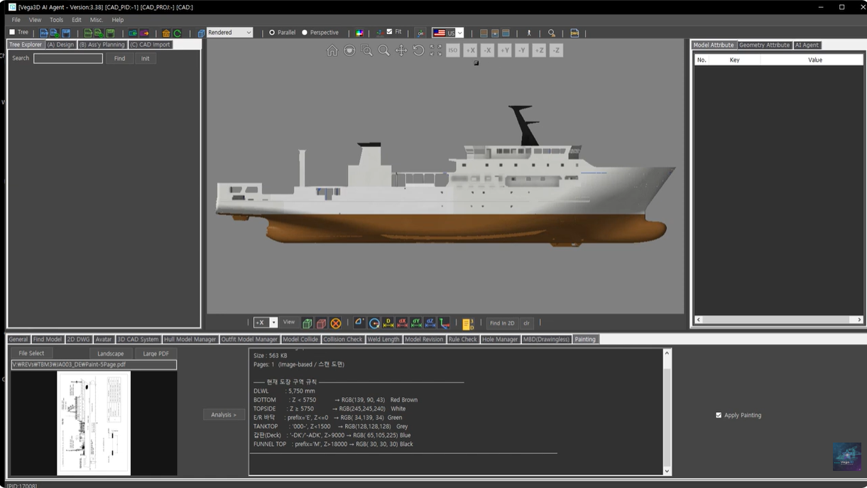
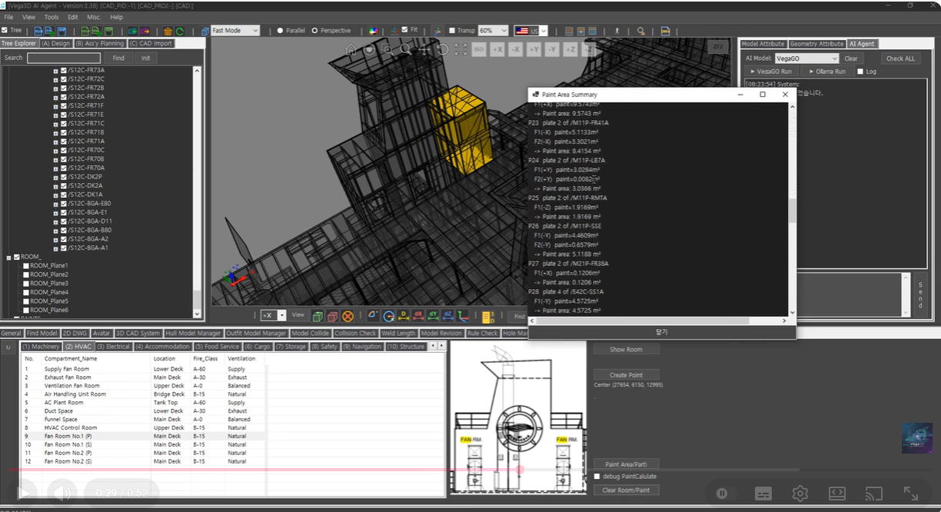
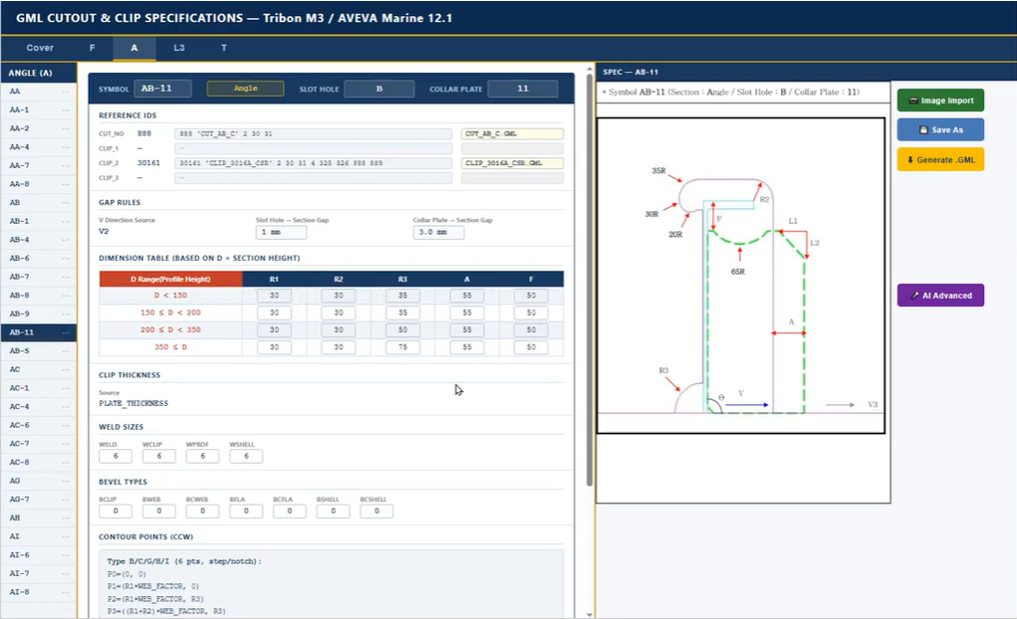
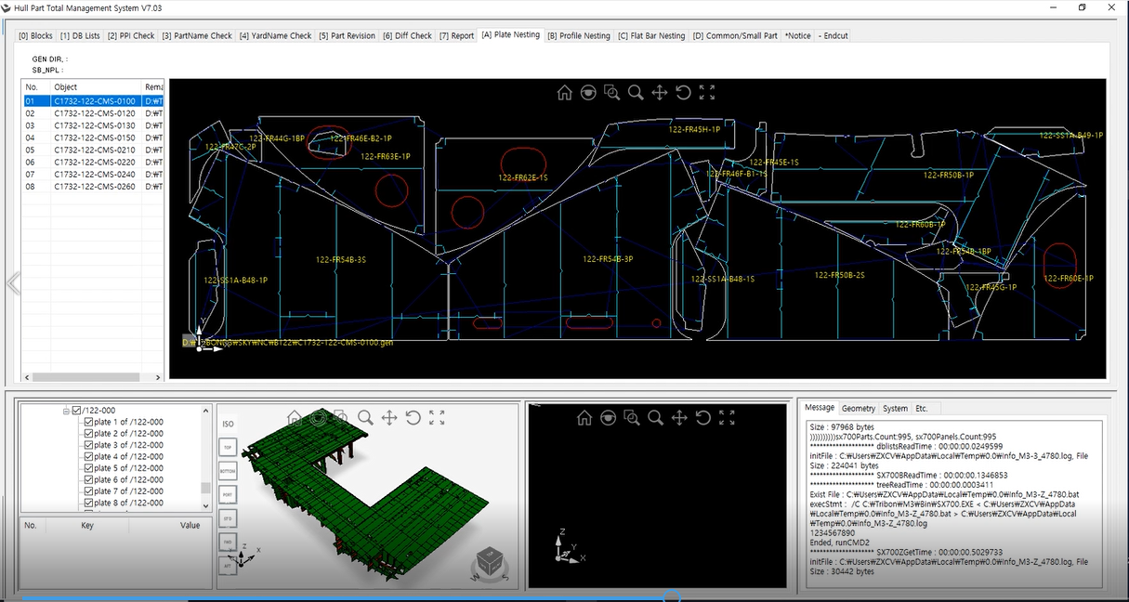
02 · Marine Solutions
02
(C)
Marine Solutions
AI-driven analysis, search and generation across your 3D data.
M17
Paint Area
Fast File Format Converter & Merge
★ Automatically identifies paint-area from the 3D ship model.
★ Fast and accurate analysis even for large-scale ship and plant models.
★ Enhances painting management and production preparation.
★ Improves accuracy in material estimation while reducing manual calc. time.
★ Filtering opti. allow external/internal selection, hole removal, and more.
M18
GML Generation
Fast File Format Converter & Merge
★ AI Agent auto. generates GML programs for Slot Holes and Collar Plates.
★ Based on AVEVA Marine / TRIBON production design rules.
★ Instantly interprets cut-out specs and creates accurate geometry.
★ Easily add new types; Bevel & Weld info can be extended with AI.
M19
3D Model Revision Check
Comparison of the model's geometric accuracy and topological Integrity
★ Name Normalization ★ Geometry & Topology
★ Based Comparison -Large Model Loading ★ Dual Viewport Sync.
★ See-Through Highlight ★ Unified Viewport Config
vega3d.xyz
06 / 08

Slide 7
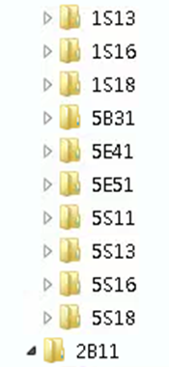
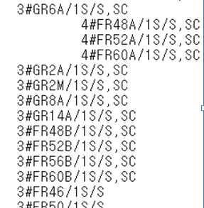

02 · Marine Solutions
02
(D)
Marine Solutions
AI-driven analysis, search and generation across your 3D data.
M20
Ass’y Plan’g Tree Auto.
Linking real-time configuration and 3D visualization of the mounting and assembly tree
★ Support for automatic configuration of Assembly Planning items based on
model naming schemes or model attribute information
★ Real-time update management of hundreds of thousands of components
within a construction project using a single tree system
★ Performing system automation using Windows Task Scheduler
★ Utilizing accurate models for each stage in the field applic. of CAD modeling
M21
More Solutions
Solutions for improving work efficiency in production sites
★ Block & Erection Accuracy Control System
★ Block Support Arrangement System
★ Block Arrangement Information Generation System
★ Lifting Lug Design Support System
vega3d.xyz
07 / 08

Slide 8


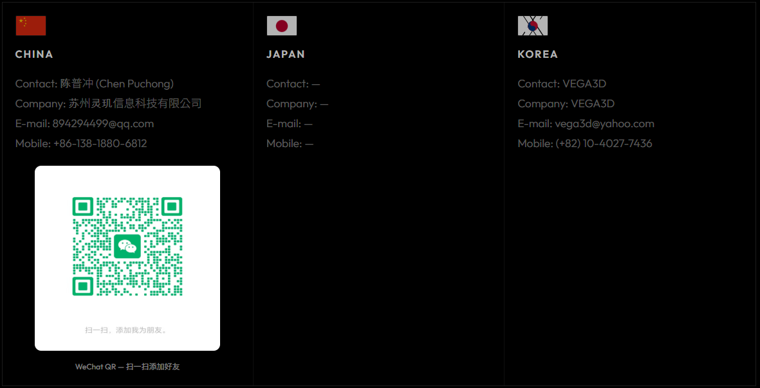
CONTACT
* Request a Demo
Vega3D is an AI-powered visualization platform for massive 3D datasets.
We support tailored demos and proofs-of-concept for your environment.
PLATFORM
Web
Windows Desktop (PC)
On-Premise
Cloud
vega3d.xyz
08 / 08

